Slide 1

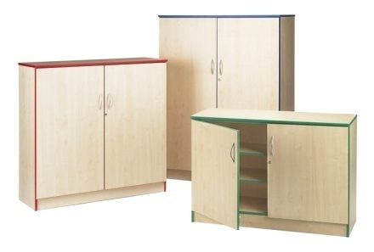
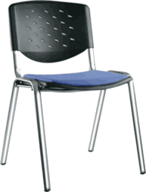
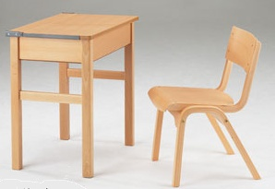
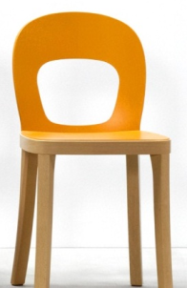
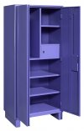

AT THE
FOUNDATION
OF EDUCATION
FOR MORE THAN 20 YEARS

Slide 2



WELCOME
Since our founding in 1991, design integrity has been our guiding principle as we offer insight into the way business is changing and into what’s possible—now and for the future.
We believe good design is good business. Our commitment to modern design has yielded a comprehensive portfolio of furniture products and textiles designed to provide enduring value and help clients shape their workspaces with imagination and vision.
Welcome & What’s New
At Adityas, our go-forward strategy focuses on the entire range of our office, residential and educational products . In this catalog, you will find that we’ve truly centered on the theme of strength, stability and endurance – qualities that we believe make us the right choice for you and your customers.
We understand that we can’t simply live off our past successes – we have to move forward, progress and continue to offer quality products and unbeatable service. In order to achieve these goals, we are making significant changes within our product portfolio. We can help you in multiple areas of your projects, from employee’s cabinet to conference room, living room to kitchen and Pre School to Graduate School,
Thank you for your business, and we look forward to serving you well into the future!
2 Welcome & What’s New
www.adityas.co.in

Slide 3

Table of Contents
WELCOME
STORAGE AND LOCKER UNITS
Welcome
2
4100 Series Cupboards
40
4200 Series Storage Bookcase
41
RECEPTION FURNITURE
4200 Series Storage Bag/ Lunchbox
42
8100 Series Reception Seating
5
4300 Series Box Storage
43
4500 Series Double Storage Trolley
Table of Contents
8200 Series Reception Seating
6
4600 Series Locker Units
43
8300 Series Reception Seating
7
45
CAFETARIA FURNITURE
MEETING ROOM FURNITURE
3100 Series Cafetaria Chair
48
5200 Series Meeting Table
12
3100 Series Cafetaria Table
49
5300 Series Meeting Table
13
3200 Series Cafetaria Chair
50
5400 Series Meeting Table
14
3300 Series Cafetaria Chair
51
3400 Series Cafetaria Chair
52
CLASSROOM FURNITURE
3500 Series Cafetaria Chair
53
1100 Series Combo Double Desk
16
3600 Series Cafetaria Chair
54
1200 Series Writing Pad Chair
17
3100 Series Cafetaria Stool
55
1600 Series Single Chair
18
3300 Series Cafetaria Stool
56
1400 Series Single Chair
19
3400 Series Cafetaria Table
57
1300 Series Writing Pad Chair
20
OFFICE FURNITURE
1100 Series Classroom Tables
21
9100 Series Director Chair
59
1700 Series Sloping Locker Desk
22
9200 Series Executive Chair
64
1800 Series Wooden Desk- Chair
23
9300 Series Workstation Chair
67
1900 Series Wooden Chair
24
9400 Series Computer Chair
70
1900 Series Wooden Teacher's Desk
9100 Series Visitor Chair
72
9200 Series Executive Workdesk
74
EARLY CHILDHOOD FURNITURE
9500 Series Filing Cabinets
77
6100 Series Early Childhood Seating
26
9300 Series Filing Cabinets
78
6300 Series Early Childhood Seating
27
9500 Series Bookcase
81
6200 Series Early Childhood Seating
28
9300 Series Bookcase
82
6400 Series Early Childhood Seating
29
MISCELLANEOUS FURNITURE
6100 Series Early Childhood Seating
7100 Series Display Unit
83
LIBRARY AND LAB FURNITURE
7300 Series Writing Board
84
7300 Series Notice Board
85
2100 Series Study Carrels
31
7400 Series Residential Range
86
2300 Series Display Units
32
Colour and Fabric Options
2300 Series Misc Units
35
Laminate Options
88
2300 Series Circulation Desk
36
Paints and Finishes
88
2400 Series Circulation Desk
37
Polypropylene Plastic
88
2300 Series Lab Stool
38
Fabric Options
88
2300 Series Lab Table
38
www.adityas.co.in
Table of Contents 3

Slide 4
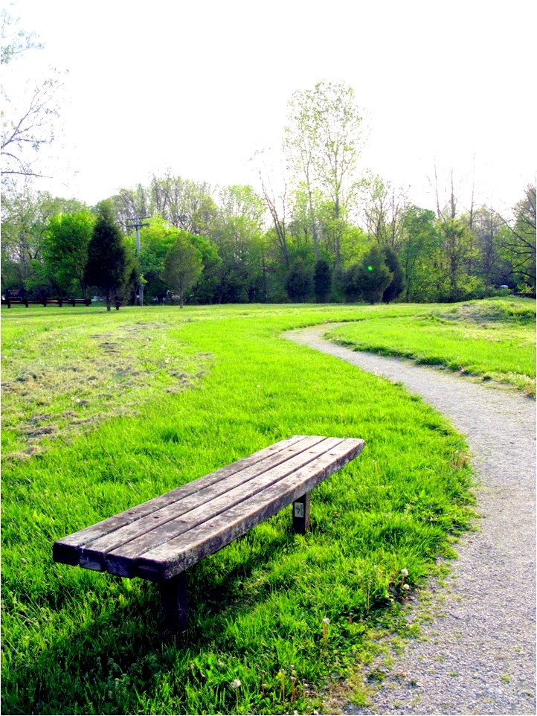
THE WAIT
MADE
COMFORTABLE
www.adityas.co.in
4 Reception Furniture

Slide 5
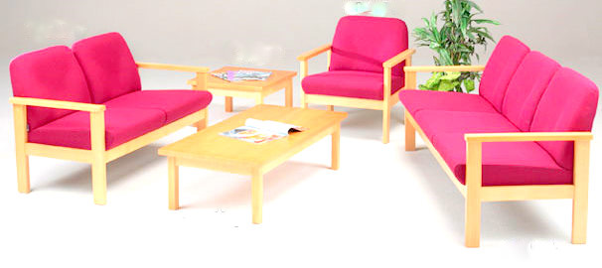
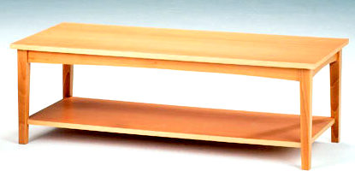
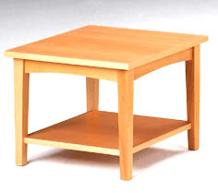
8100 SERIES RECEPTION SEATING
Constructed in solid wood frame.
Full choice of fabrics .
Available as a unit chair, single arm chair (LH or RH when seated) and armchair in both low and medium back
Coffee Tables are simple, functional and made with solid Natural borotik frames and laminated/ vennered tops.
Reception Furniture
RS 8101
RT 8112
RS 8102
RT 8111
RS 8103
RT 8113
RT 8114
made to order
1 yr guarantee
delivery 4 weeks
upholstery options
Reception Furniture 5
www.adityas.co.in

Slide 6
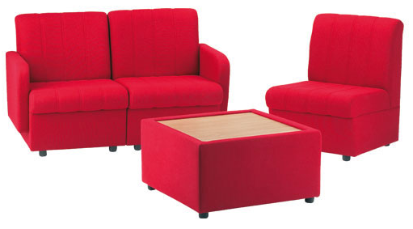
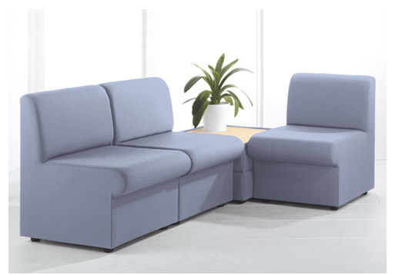
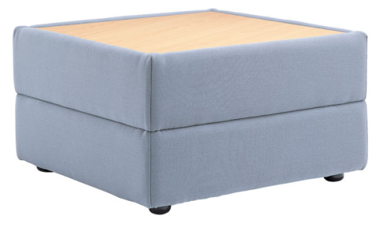
8200 SERIES RECEPTION SEATING
Reception Furniture
RS 8202
RS 8201
RT 8201
Fully upholstered range of unit chairs, with or without arms
Perfect for setting the right impression in your reception area.
Each seat is attractively quilted to add that finishing touch.
An upholstered table with a Beech laminate top is also available.
RS 8204
RS 8203
RT 8202
Versatile but simple modular solution
Wide choice of fabrics and a matching upholstered table
made to order
1 yr guarantee
delivery 4 weeks
upholstery options
www.adityas.co.in
6 Reception Furniture

Slide 7
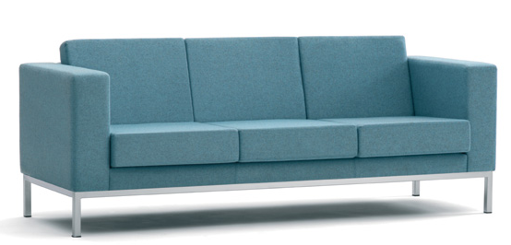
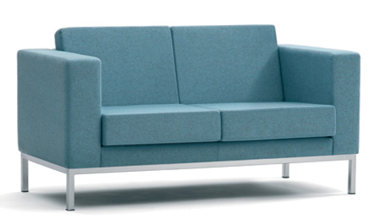
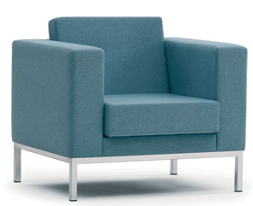
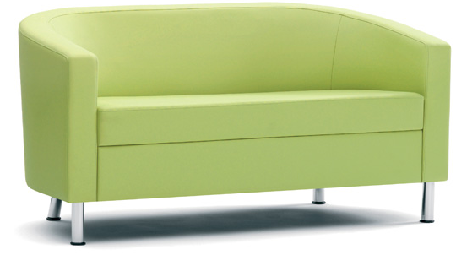
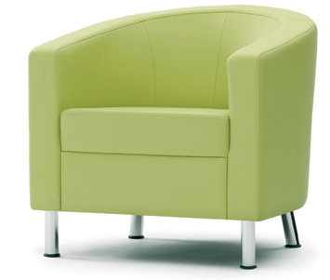
8300 SERIES RECEPTION SEATING
Reception Furniture
RS 8303
RS 8302
RS 8301
Steel feet in a Silver finish
Available in various fabric options
Chrome legs
Available in various fabric options
RS 8305
RS 8304
made to order
1 yr guarantee
delivery 6 weeks
upholstery options
Reception Furniture 7
www.adityas.co.in

Slide 8
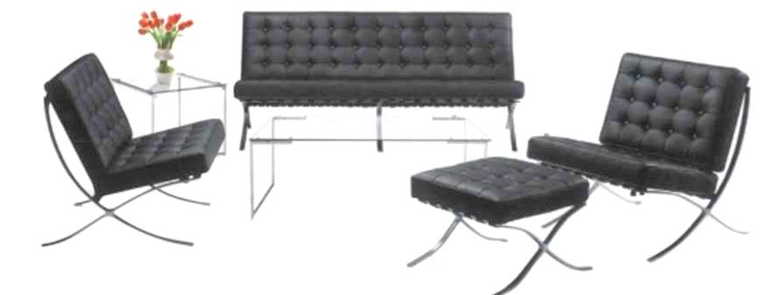
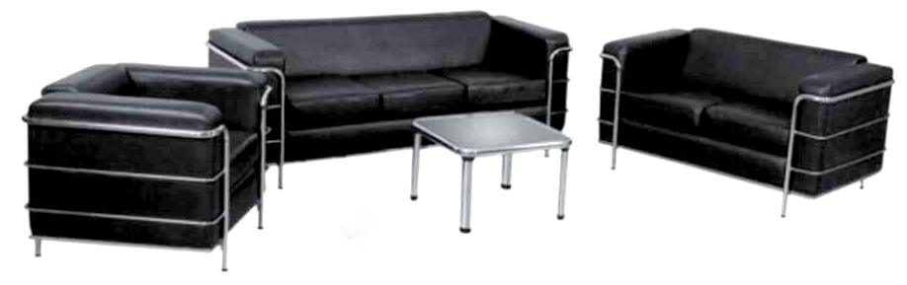
8300 SERIES RECEPTION SEATING
Reception Furniture
RS 8308
RS 8306
RS 8306
RS 8307
Steel feet in a Silver finish
Available in various fabric options
RS 8311
RT 8301
RS 8310
RS 8309
Steel legs
Table in stainless steel with Glass top
made to order
1 yr guarantee
delivery 6 weeks
upholstery options
www.adityas.co.in
8 Reception Furniture

Slide 9
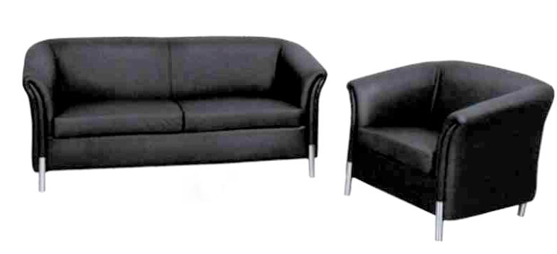
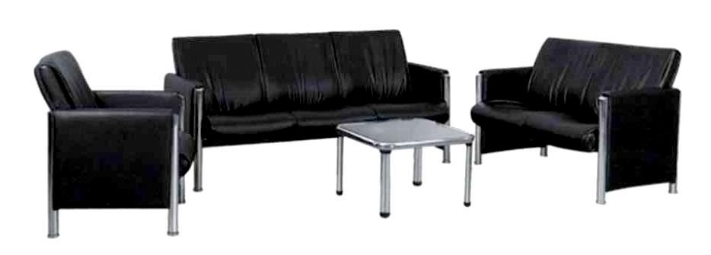
8300 SERIES RECEPTION SEATING
Reception Furniture
RS 8313
Chrome legs
Available in various fabric options
RS 8312
RS 8316
RT 8301
RS 8315
RS 8314
Steel legs
Table in stainless steel with Glass top
made to order
1 yr guarantee
delivery 6 weeks
upholstery options
Reception Furniture 9
www.adityas.co.in

Slide 10
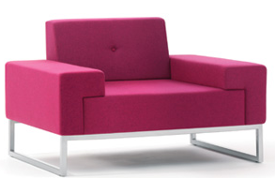
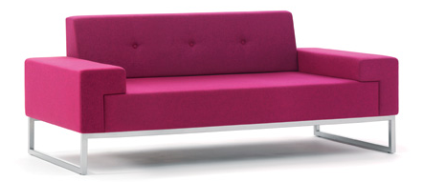
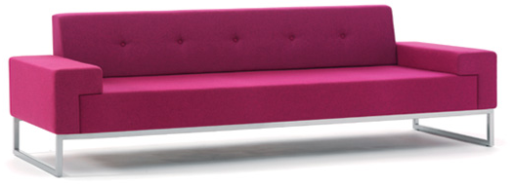
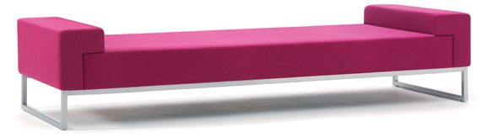
8300 SERIES RECEPTION SEATING
Reception Furniture
RS 8317
RS 8318
RS 8319
RS 8320
made to order
1 yr guarantee
delivery 6 weeks
upholstery options
www.adityas.co.in
Reception Furniture 10

Slide 11

COLLABORATE AND
REACH
HIGHER
www.adityas.co.in
Meeting Room Furniture 11

Slide 12
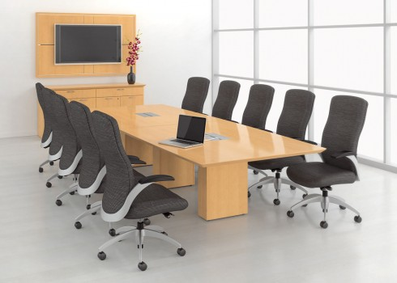
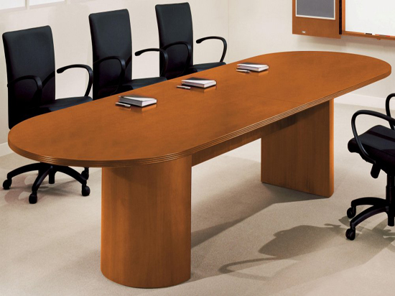
5200 SERIES MEETING TABLE
Meeting Room Furniture
MT 5201
Legs/ support made in commercial plywood and solid wood.
18mm veneered top with lacquer finish.
Provision for electrical fittings on top.
MT 5202
made to order
1 yr guarantee
delivery 6 weeks
www.adityas.co.in
Meeting Room Furniture 12

Slide 13
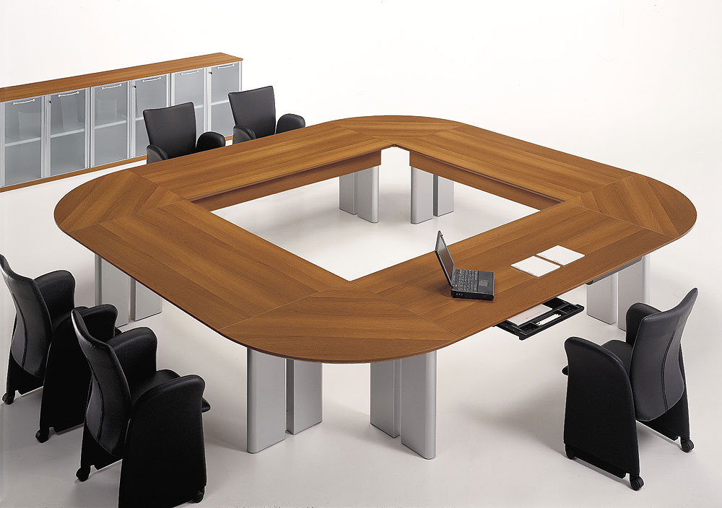
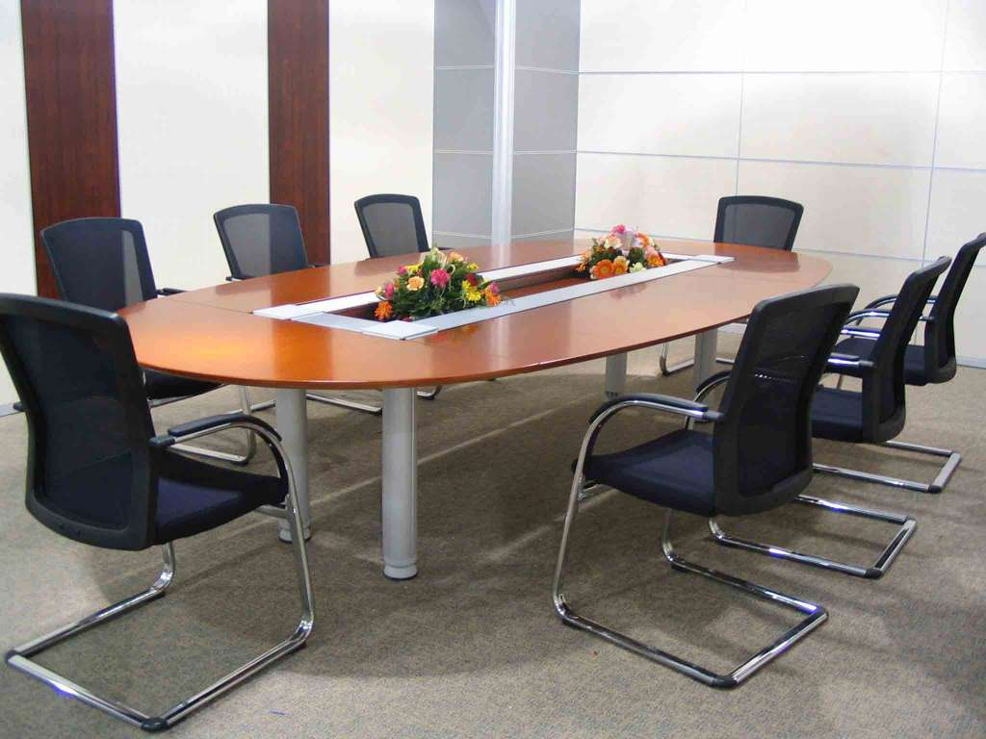
5300 SERIES MEETING TABLE
Meeting Room Furniture
Wooden top made using laminated plywood/ MDF.
Structure made of 18mm plywood in aluminum finish.
MT 5301
MT 5302
made to order
1 yr guarantee
delivery 8 weeks
Meeting Room Furniture 13
www.adityas.co.in

Slide 14
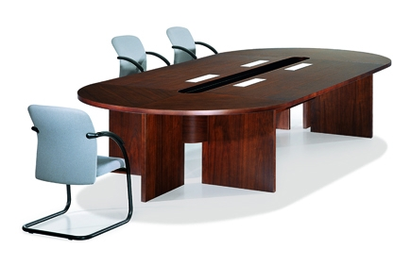
5400 SERIES MEETING TABLE
Meeting Room Furniture
MT 5401
Legs/ support made in commercial plywood with laminate on both sides
Top made in commercial plywood with laminate
Complete with polished wooden moulding on top.
made to order
1 yr guarantee
delivery 6 weeks
www.adityas.co.in
Meeting Room Furniture 14

Slide 15
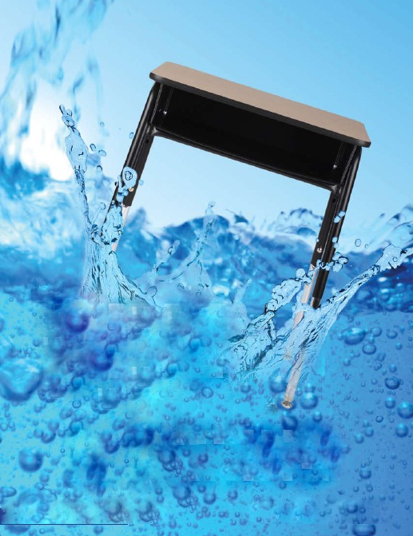
DIVE
INTO
LEARNING
www.adityas.co.in
Classroom Furniture 15

Slide 16
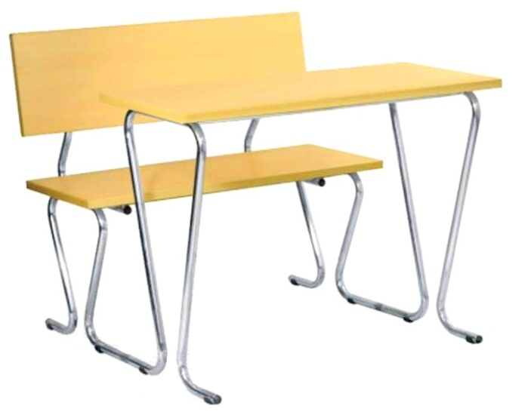
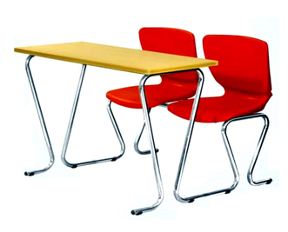
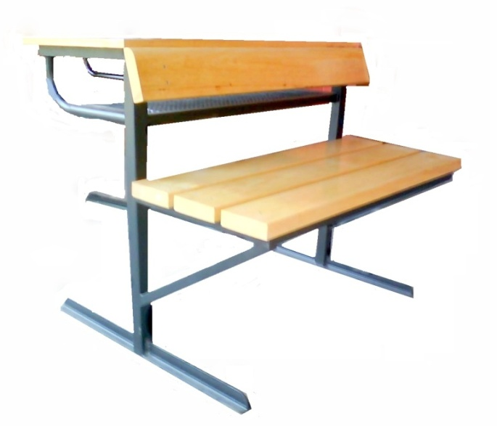

1100 SERIES COMBO DOUBLE DESK
1.25” tubular steel frame .
12mm MDF and 1mm laminated back and seat.
36” x 24” (5 degree slope) top
High pressure laminate top with t-mold edge.
18”seat height.
16” belly clearance.
Classroom Furniture
DD 1101
0.75” thick, thermoset plastic seats and backs are scratch-resistant, and easy to clean.
1.25” tubular steel frame (chrome finish).
36” x 24” high pressure laminate top (5 degree slope).
18”seat height.
16” belly clearance.
DD 1102
The strongest combo series.
1.5” borotik panel seats and back.
1.25” tubular iron frame (powder coating finish).
36” x 24” high pressure Plywood with laminate top (5 degree slope).
18”seat height.
Steel wire mesh book basket.
DD 1103
made to order
1 yr guarantee
delivery 6 weeks
Classroom Furniture 16
www.adityas.co.in

Slide 17
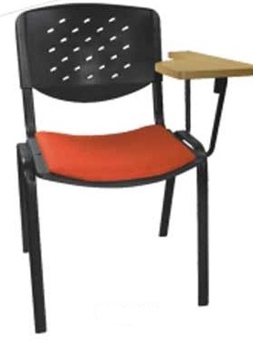
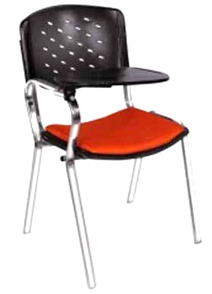
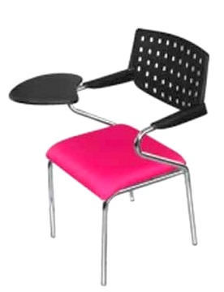
1200 SERIES WRITING PAD CHAIR
1.25” tubular steel frame (powder coating finish).
0.75” thick, thermoset plastic seats and backs are scratch-resistant.
8mm detachable upholstered cushion on seat
High pressure laminate top with t-mold edge writing pad
18”seat height.
16” belly clearance.
Classroom Furniture
WC 1201
1.25” tubular steel frame (chrome finish).
0.75” thick thermoset plastic seats and backs are scratch-resistant.
8mm detachable upholstered cushion on seat
Thermoset plastic writing pad.
18”seat height.
16” belly clearance.
WC 1202
1.25” tubular steel frame with chrome finish
0.75” thick, thermoset plastic back is scratch-resistant.
8mm upholstered cushioned seat.
High pressure propylene turnable writing pad
18”seat height.
16” belly clearance.
WC 1203
made to order
1 yr guarantee
delivery 6 weeks
www.adityas.co.in
17 Classroom Furniture

Slide 18
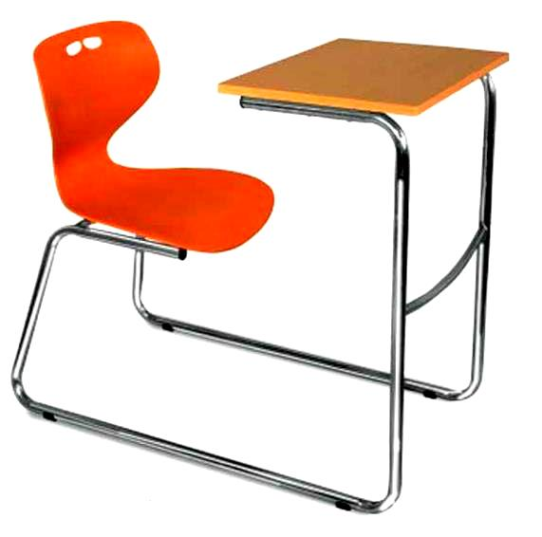
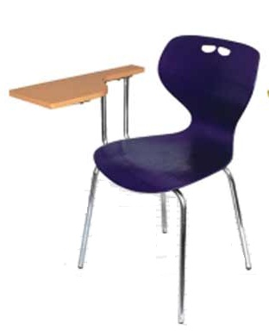
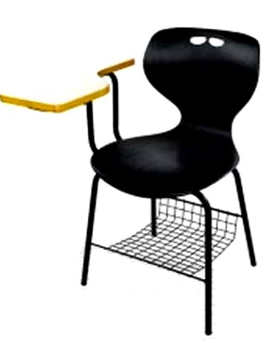
1600 SERIES SINGLE CHAIR
Double entry design for easy access.
Sled base is perfect for carpeted areas.
0.75” thick, thermoset plastic seats are scratch-resistant, and easy to clean.
Heavy duty 1.25” tubular steel frame (chrome finish).
16” x 24” high pressure laminate top with t-mold edge (5 degree slope).
18”seat height, 16” belly clearance.
Classroom Furniture
WC 1601
1.25” tubular steel frame with chrome finish
0.75” thick, thermoset plastic seats and backs are scratch-resistant.
High pressure laminate top with t-mold edge turnable writing pad.
18”seat height, 16” belly clearance.
WC 1602
1.25” tubular steel frame with chrome finish
5/8” thick, thermoset plastic seats and backs are scratch-resistant.
High pressure laminate top with t-mold edge writing pad.
Heave gauge wire bookrack
18”seat height, 16” belly clearance.
WC 1603
made to order
1 yr guarantee
delivery 6 weeks
Classroom Furniture 18
www.adityas.co.in

Slide 19
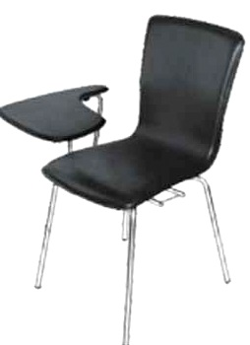
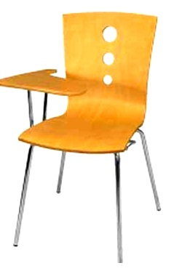
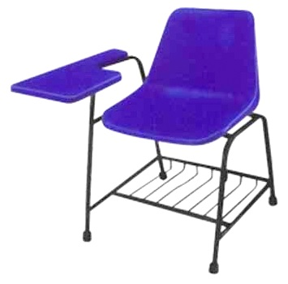
1400 SERIES SINGLE CHAIR
1 1/8” tubular steel frame with chrome finish
5/8” thick, upholstered and cushioned seat and back over L-shape bent 12mm ply.
High pressure propylene turnable writing pad
18”seat height.
16” belly clearance.
Classroom Furniture
WC 1401
1 1/8” tubular steel frame with chrome finish
12mm L-shape ply seat back shell
High pressure propylene turnable writing pad
18”seat height.
16” belly clearance.
Available in left and right orientation.
WC 1402
1 1/8” tubular steel frame with enamel finish
0.75” thick, thermoset plastic seats and backs are scratch-resistant .
Thermostat plastic turnable writing pad
Heavy gauge wire book rack
18”seat height, 16” belly clearance.
WC 1403
made to order
1 yr guarantee
delivery 6 weeks
www.adityas.co.in
19 Classroom Furniture

Slide 20
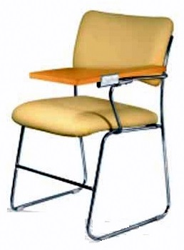
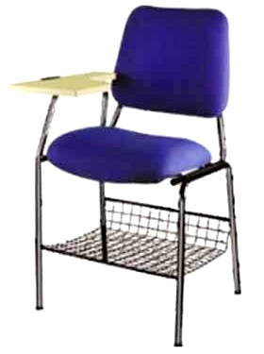
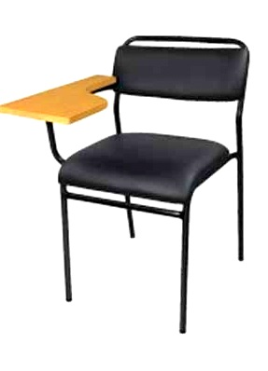
1300 SERIES WRITING PAD CHAIR
1.25” tubular steel frame with enamel finish
5/8” thick, upholstered cushioned seat and back.
High pressure laminate top with turnable writing pad.
18”seat height.
16” belly clearance.
Classroom Furniture
WC 1301
1.25” tubular steel frame with enamel finish
2” thick, upholstered cushioned seat and back.
High pressure laminate top with t-mold edge writing pad.
Heavy gauge wire book rack
18”seat height., 16” belly clearance.
WC 1302
1 1/8” tubular steel frame with enamel finish
2” thick, upholstered cushioned seat and back.
High pressure laminate top with writing pad.
18”seat height.
16” belly clearance.
WC 1301
made to order
1 yr guarantee
delivery 6 weeks
Classroom Furniture 20
www.adityas.co.in

Slide 21
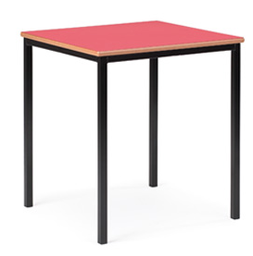
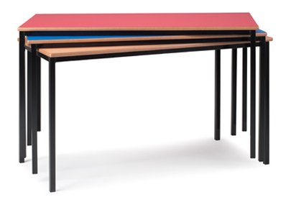
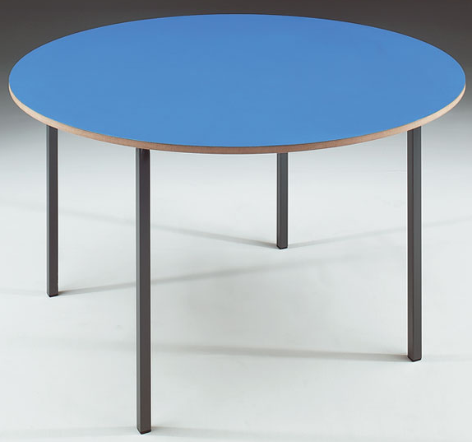
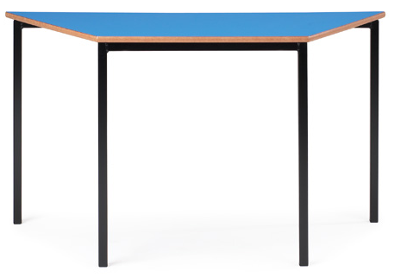
1100 SERIES CLASSROOM TABLES
Classroom Furniture
CT 1101
CT 1102
16 gauge fully welded Black frame.
Wipe-clean 18mm laminate tops with rounded MDF edges.
Four multi-functional shapes and a variety of top colours.
Rectangular and square shapes spirally stack.
Tables can be arranged in a variety of ways for total flexibilty.
Height options 460, 530, 590, 640 and 710mm.
CT 1103
CT 1104
made to order
1 yr guarantee
delivery 6 weeks
www.adityas.co.in
21 Classroom Furniture

Slide 22




1700 SERIES SLOPING LOCKER DESK
Classic Classroom
CD 1701
Exceptionally high standard with solid borotik wood frame.
Laminated MDF / plywood tops so all the timbers are perfectly matched.
Deep internal lockers with a depth of 125mm, mortise and tenon joints - glued and pinned for extra strength.
Improved hinges for an overall exceptional finish.
Available as single and double desks
made to order
1 yr guarantee
delivery 6 weeks
CD 1702
Classroom Furniture 22
www.adityas.co.in

Slide 23



1800 SERIES WOODEN DESK AND CHAIR
Classroom Furniture
CD 1801
CD 1802
The sturdiest classroom desk
Legs and frame made in borotik wood and finished with melamine polish
18mm commercial plywood with laminate on top and sides.
Under-hand wooden book rack, Special pencil grooves on top.
Available in double and single options.
Legs and frame made in borotik wood with melamine finish
12mm commercial ply seat and back
Available in three seat heights 13”, 15” and 16”
Full size teacher's chair 17”also available.
CS 1801
made to order
1 yr guarantee
delivery 6 weeks
www.adityas.co.in
23 Classroom Furniture

Slide 24



1900 SERIES WOODEN CHAIR
Classroom Furniture
borotik wood legs and frame with melamine finish
12mm commercial ply seat and back
Available in six sizes from Early years through to university.
Strong laminated frame with lacquered shaped seat and back.
CS 1901
1900 SERIES WOODEN TEACHER’S DESK
Legs and frame made in borotik and with melamine finish
18mm commercial plywood with 1mm laminate on top, sides, and drawers.
Single pedestal desk in three sizes with either two or three drawers (LH or RH when seated) and a double pedestal desk with two or three drawers in any combination.
The two drawer pedestals have a lower filing drawer suitable for A4 or Foolscap files.
CT 1901
CT 1902
made to order
1 yr guarantee
delivery 6 weeks
Classroom Furniture 24
www.adityas.co.in

Slide 25

NOURISH
MINDS &
WATCH THEM
GROW
25 Early Childhood
www.adityas.co.in

Slide 26




6100 SERIES EARLY CHILDHOOD SEATING
Early Childhood
PS 6101
PS 6102
PS 6103
Made in solid borotik and commercial plywood.
Choice of variuos shapes and designs.
Available in enamel paint/ duco paint/ natural polish.
PT 6101
PS 6104
made to order
1 yr guarantee
delivery 6 weeks
www.adityas.co.in
Early Childhood 26

Slide 27




6100 SERIES EARLY CHILDHOOD SEATING
Made in commercial plywood
Scope for storage, reading, and writing tables
Compartment for kinderbox
Available in enamel/ duco paint.
Stools made in borotik wood
Design painted on top
Various designs available
Early Childhood
PT 6102
PS 6105
made to order
1 yr guarantee
delivery 6 weeks
Two and three seater benches
Made from solid borotik,
Can be used in a quiet corner to encourage the reading of books or general group activities around a table.
PS 6106
PS 6107
27 Early Childhood
www.adityas.co.in

Slide 28





6300 SERIES EARLY CHILDHOOD SEATING
Solid borotik frames and laminated tops
Chairs have coloured lacquered seats and backs on a solid borotik frame.
Offered in three heights, making them suitable for nursery schools.
Tables come in four shapes: Rectangle, Square, Round, Trapezoidal.
Early Childhood
PS 6301
PT 6301
PT 6304
PT 6302
made to order
1 yr guarantee
delivery 6 weeks
www.adityas.co.in
Early Childhood 28

Slide 29


6200 SERIES EARLY CHILDHOOD SEATING
19mm commercial plywood top
Legs and frame made in polished borotik
Wave design- can be used in collaboration of different patterns.
Available in four colour options.
Early Childhood
PT 6203
made to order
1 yr guarantee
PS 6205
delivery 6 weeks
6400 SERIES EARLY CHILDHOOD SEATING
PT 6401
PS 6401
available from stock
Emphasis on good posture, helping to maintain a healthy body.
Available in an exciting range of primary colours
Excellent stability and stackability.
1 yr guarantee
29 Early Childhood
www.adityas.co.in

Slide 30

OPEN UP
TO A NEW WORLD OF
LEARNING
www.adityas.co.in
30 Library and Lab Furniture

Slide 31



2100 SERIES STUDY CARRELS
Can be used singly, butted side by side or back to back.
Manufactured with a strong 16g Black frame and generously sized carrel in Beech laminate panels with lacquered MDF edges.
Includes a useful top book shelf D210mm and a cable port outlet.
Ideal for libraries and study areas.
Library and Lab Furniture
LC 2101
Made with a fully welded double leg frame in Light Grey finish, with feet levellers.
Carrel made in commercial plywood with laminate on both sides.
Work surface of W765mm by D680mm and a working height of 720mm with a useful top shelf D250mm.
Available as a single or double unit.
LC 2102
Made in 19mm commercial board/ plywood
Laminated on both sides in desired colour/ texture.
LC 2103
made to order
1 yr guarantee
delivery 6 weeks
Library and Lab Furniture 31
www.adityas.co.in
Notes:
Lan

Slide 32



2300 SERIES DISPLAY UNITS
Flat Shelf Unit
Easily display books, multimedia, magazines and more.
Solid construction features 19mm thick panels with multi-ply veneer and 6mm solid shelves
Each holds upto 150 lbs.
All exposed edges are finished with oak banding..
Flat shelves can be used for all kinds of media
Pocket shelves provide an effective face out display of magazines, novels, and picture books.
Available in different sizes as per requirement
Library and Lab Furniture
Pocket Shelf Unit
LS 2301
LS 2303
LS 2302
made to order
1 yr guarantee
delivery 6 weeks
www.adityas.co.in
32 Library and Lab Furniture

Slide 33





2300 SERIES DISPLAY UNITS
CD Display Unit
Revolving Dictionary Stand
Library and Lab Furniture
LS 2304
Stacked Display Unit
LS 2305
Atlas Stand
LS 2306
Dictionary Standc
LS 2307
LS 2308
made to order
1 yr guarantee
delivery 6 weeks
Library and Lab Furniture 33
www.adityas.co.in

Slide 34





2300 SERIES DISPLAY UNITS
Periodical Shelving
Magazine and Newspaper Shelving
Library and Lab Furniture
Newspaper Rack
LS 3310
LS 3309
Slatwall Panels
End of Range Book Truck
LS 3311
LS 3313
LS 3312
made to order
1 yr guarantee
delivery 6 weeks
www.adityas.co.in
34 Library and Lab Furniture

Slide 35





2300 SERIES MISC UNITS
Book Return Units
Computer Workstation
Library and Lab Furniture
LU 2301
LU 2306
LU 2307
Tri Base Computer Center
Online Monitor Units
LU 2308
LU 2307
Book Trolleys
LU 2303
LU 2302
LU 2304
LU 2305
made to order
5 yr guarantee
delivery 6 weeks
Library and Lab Furniture 35
www.adityas.co.in

Slide 36



2300 SERIES CIRCULATION DESKS
Made in 19mm commercial plywood with veneer/ laminate facing.
Tops made in ply-core high pressure laminate surface.
Edges finished with solid teak banding
Full tops or patron ledges available on workstation components.
Drawer fronts and boxes are 19mm thick with full extension drawer slides.
Book return component features front slot.
Coordinating depressible book card available.
Wide variety of storage options and accessories customize each desk.
Library and Lab Furniture
Workdesk with Corner
Book Drop Unit
LD 2301
made to order
1 yr guarantee
delivery 6 weeks
www.adityas.co.in
36 Library and Lab Furniture

Slide 37






2400 SERIES CIRCULATION DESKS
3400 Series Circulation desk has unique new features with adaptable modularity that makes it work for any library, big or small. From the easy-care, solid resin work surface that gives the look and feel of granite to the beautiful, yet practical, canted front for patron comfort, this desk provides the ultimate in functionality while delivering undeniable appeal.
Library and Lab Furniture
LD 2401
Open Shelf
with Patron Ledge
Work Desk
Book Drop
Unit
Drawer Cabinet
Corner Units
made to order
1 yr guarantee
delivery 6 weeks
Library and Lab Furniture 37
www.adityas.co.in

Slide 38




2300 SERIES LAB STOOL
Library and Lab Furniture
LS 2301
Made from solid borotik frame with glued and pinned mortise and tenon joints for long lasting strength.
Solid borotik seat 330mm square with useful hand-hold
Finished in natural lacquer.
Also available with an integral backrest (LS3302).
LS 2302
2300 SERIES LAB TABLE
LT 2302
LT 2301
Solid borotik frame and 19mm deep veneered top with solid borotik lippings.
Choose from rectangular, semi-circular and library tables in natural beech veneer.
Selected for libraries, staff rooms and common rooms
made to order
1 yr guarantee
delivery 6 weeks
www.adityas.co.in
38 Library and Lab Furniture

Slide 39

STORAGE
AS SAFE AS
TRUNK
Storage and Locker Units 39
www.adityas.co.in

Slide 40





4100 SERIES CUPBOARDS
Tall Two Section Cupboard
Tall Double Cupboard
Low Storage Cupboard
Storage and Locker Units
SC4103
SC4102
Small Lockable Cupboard
SC4101
Duo Storage Cupboard
SC4104
SC4105
Comprehensive range of ready assembled and practical units.
Manufactured with laminated plywood panels and matching PVC edges for durability.
Strong 18mm back panels for improved stability and extra rigidity.
made to order
1 yr guarantee
delivery 6 weeks
www.adityas.co.in
40 Storage and Locker Units

Slide 41


4200 SERIES STORAGE BOOKCASE
Storage and Locker Units
Bookcase with Sliding Glass Door
SC4201
SC4202
SC4204
SC4203
Plan Chest
Made in the traditional way using fine wood veneers - Light Oak, Beech and Maple.
Choice of open style bookcases in 250mm and 350mm deep, or with sliding glass doors in 350mm deep.
SC4205
Available in two heights and three widths, all with adjustable shelves.
The design includes inset adjustable shelf strips for easier use and stronger shelf fitting.
made to order
1 yr guarantee
delivery 6 weeks
Storage and Locker Units 41
www.adityas.co.in

Slide 42




4200 SERIES BAG/ LUNCHBOX STORAGE
Tall Bag Storage
Duo Bag Storage
Bag Storage keeps your floors free from the clutter of day-to-day student activity
Rucksacks, sports bags, briefcases, indeed for anything that keeps the school environment tidy and safe.
Storage and Locker Units
SC4206
SC4207
Mobile Lunch Box Trolleys encourage children to keep their lunch boxes in the right place and can be easily transported to the right location at the right time.
Available as a Single Sided Trolley (up to 21 lunch boxes) and a Double Sided Trolley (up to 42 lunch boxes). With three shelves.
Lunch Box Trolley
SC42078
made to order
1 yr guarantee
delivery 6 weeks
www.adityas.co.in
42 Storage and Locker Units

Slide 43




4300 SERIES BOX STORAGE
Mobile Storage Units are designed to work individually or can be grouped together in a run to meet all your storage needs.
Storage and Locker Units
Shelf Unit
Cupboard Unit
Multi- Unit
A shelf unit with two adjustable shelves, a cupboard unit with lockable door and one central fixed shelf, and a multi-compartment unit.
SC4301
SC4302
SC4303
Three Units
Clubbed together
Storage for all your needs - toys, games, books and much more. The top section comprises six useful deep storage compartments for smaller items .
One Horizontal Shelf Unit
6 Compartment
Multi Compartment
SC4304
SC4305
SC4306
made to order
1 yr guarantee
delivery 6 weeks
Storage and Locker Units 43
www.adityas.co.in

Slide 44

4500 SERIES DOUBLE STORAGE TROLLEY
Double Sided Display/ Storage Trolley
A range of Primary Choice Book Trolleys with rounded coloured PVC edges in Blue, Red and Green with Beech MDF panels and castors.
Available in three storage and display options.
Storage and Locker Units
SC4501
Double Sided Book Storage Trolley
Double Sided Combination Trolley
SC4502
SC4503
made to order
1 yr guarantee
delivery 6 weeks
www.adityas.co.in
44 Storage and Locker Units

Slide 45





4600 SERIES LOCKER UNITS
Storage and Locker Units
Camlock
Hasp & Staple
SC4601
SC4602
Finest quality veneers are selected on an plywood core with margins on the carcase.
The doors have attractive radius lacquered MDF edges and may be specified with a camlock or a cut out hasp and staple.
Available as a single and two door locker both with coat hooks, three and four door lockers.
Solidly made with 19mm veneered MDF panels in a choice of three real wood finishes, 9mm backs for rigidity and hardwood handles.
Choice of doors - no locks, doors with locks and doors with hasp/staple.
Available as two, three, four and eight compartments and nine compartments.
SC4603
SC4604
made to order
1 yr guarantee
delivery 6 weeks
Storage and Locker Units 45
www.adityas.co.in

Slide 46

REVEL YOUR
BREAKS
www.adityas.co.in
Cafeteria Furniture 46

Slide 47



3100 SERIES CAFETARIA CHAIR
Back and seat made in commercial ply
Polished in desired finish
Legs and frame made in solidwood
Available in various shapes and sizes
Cafeteria Furniture
CC 3101
CC 3102
CC 3103
made to order
1 yr guarantee
delivery 4 weeks
Cafeteria Furniture 47
www.adityas.co.in

Slide 48




3100 SERIES CAFETARIA CHAIR
Cafeteria Furniture
CC 3104
CC 3105
Back and seat made in commercial ply
Polished in desired finish
Legs and frame made in solid wood
Available in various shapes and sizes
CC 3106
CC 3107
made to order
1 yr guarantee
delivery 4 weeks
www.adityas.co.in
Cafeteria Furniture 48

Slide 49



3100 SERIES CAFETARIA TABLE
Cafeteria Furniture
CT 3101
CT 3102
CT 3103
Legs and frame made in solid wood
Top made in 18mm Commercial Plywood
Polished in desired finish
Available in various shapes and sizes
made to order
1 yr guarantee
delivery 4 weeks
Cafeteria Furniture 49
www.adityas.co.in

Slide 50


3200 SERIES CAFETARIA CHAIR
Back and seat made in commercial ply
Polished with Duco paint
Legs and margins in borotik wood with melamine polish.
Available in two back shapes
Various colour options
Cafeteria Furniture
CC 3201
CC 3201
CC 3201
CC 3202
made to order
1 yr guarantee
delivery 4 weeks
www.adityas.co.in
Cafeteria Furniture 50

Slide 51




3300 SERIES CAFETARIA CHAIR
Cafeteria Furniture
CC 3301
CC 3302
Cushioned back and seat
Legs and frame made in stainless steel
Available in various shapes and sizes
Various upholstery options
CC 3303
CC 3304
made to order
1 yr guarantee
delivery 6 weeks
upholstery options
Cafeteria Furniture 51
www.adityas.co.in

Slide 52




3400 SERIES CAFETARIA CHAIR
Cafeteria Furniture
CC 3401
CC 3402
Polypropylene seat in a choice of 6 colours
Legs and frame made in steel
Available in various shapes and sizes
CC 3403
CC 3404
made to order
1 yr guarantee
delivery 5 weeks
www.adityas.co.in
Cafeteria Furniture 52

Slide 53






3500 SERIES CAFETARIA CHAIR
Cafeteria Furniture
CC 3501
CC 3502
Legs and frame made in chrome finished steel
Seat/ back in plywood
Available in various designs
CC 3503
CC 3504
CC 3505
CC 3506
made to order
1 yr guarantee
delivery 2 weeks
Cafeteria Furniture 53
www.adityas.co.in

Slide 54





3600 SERIES CAFETARIA CHAIR
Cafeteria Furniture
CC 3601
CC 3602
CC 3603
Lightweight and strong all weather outdoor chairs
Chrome/ weave legs
CC 3604
CC 3605
made to order
1 yr guarantee
delivery 3 weeks
www.adityas.co.in
Cafeteria Furniture 54

Slide 55






3100 SERIES CAFETARIA STOOL
Cafeteria Furniture
CS 3101
CS 3103
CS 3104
CS 3102
Cushioned back and seat made in commercial ply
Polished in desired finish
Legs and frame made in solid wood
Available in various shapes and sizes
CS 3105
CS 3106
CS 3107
made to order
1 yr guarantee
delivery 3 weeks
Cafeteria Furniture 55
www.adityas.co.in

Slide 56






3300 SERIES CAFETARIA STOOL
Cafeteria Furniture
CS 3301
CS 3302
CS 3303
Cushioned back and seat with hydraulic
Legs and frame made in steel
Available in various shapes and sizes
Various upholstery options
CS 3304
CS 3305
CS 3306
made to order
1 yr guarantee
delivery 3 weeks
www.adityas.co.in
Cafeteria Furniture 56

Slide 57




3400 SERIES CAFETARIA TABLE
Cafeteria Furniture
CT 3401
CT 3402
CT 3403
CT 3404
Legs and frame made in chrome/ powder coated finished steel
Top made in laminated 18mm commercial plywood
Available in various shapes and sizes
made to order
1 yr guarantee
delivery 3 weeks
Cafeteria Furniture 57
www.adityas.co.in

Slide 58

FOR THE ROAD
BEYOND
SUCCESS
www.adityas.co.in
Office Furniture 58

Slide 59





9100 SERIES DIRECTOR CHAIR
Office Furniture
DC 9102
DC 9101
DC 9103
DC 9104
DC 9105
Office Furniture 59
www.adityas.co.in

Slide 60





9100 SERIES DIRECTOR CHAIR
Office Furniture
DC 9106
DC 9107
DC 9108
DC 9109
DC 9110
www.adityas.co.in
60 Office Furniture

Slide 61





9100 SERIES DIRECTOR CHAIR
Office Furniture
DC 9111
DC 9112
DC 9113
DC 9114
DC 9115
Office Furniture 61
www.adityas.co.in

Slide 62





9100 SERIES DIRECTOR CHAIR
Office Furniture
DC 9116
DC 9117
DC 9118
DC 9119
DC 9120
www.adityas.co.in
62 Office Furniture

Slide 63





9100 SERIES DIRECTOR CHAIR
Office Furniture
DC 9121
DC 9122
DC 9123
DC 9124
DC 9125
Office Furniture 63
www.adityas.co.in

Slide 64





9200 SERIES EXECUTIVE CHAIR
Office Furniture
EC 9201
EC 9202
EC 9203
EC 9204
20
EC 9205
www.adityas.co.in
64 Office Furniture

Slide 65





9200 SERIES EXECUTIVE CHAIR
Office Furniture
EC 9206
EC 9207
EC 9208
EC 9209
EC 9210
Office Furniture 65
www.adityas.co.in

Slide 66





9200 SERIES EXECUTIVE CHAIR
Office Furniture
EC 9211
EC 9212
EC 9213
EC 9214
EC 9215
www.adityas.co.in
66 Office Furniture

Slide 67





9300 SERIES WORKSTATION CHAIR
Office Furniture
EC 9301
EC 9302
EC 9303
EC 9304
EC 9305
Office Furniture 67
www.adityas.co.in

Slide 68





9300 SERIES WORKSTATION CHAIR
Office Furniture
EC 9306
EC 9307
EC 9308
EC 9309
EC 9310
www.adityas.co.in
68 Office Furniture

Slide 69






9300 SERIES WORKSTATION CHAIR
Office Furniture
EC 9311
EC 9312
EC 9313
EC 9314
EC 9315
EC 9316
Office Furniture 69
www.adityas.co.in

Slide 70





9400 SERIES COMPUTER CHAIR
Office Furniture
CC 9401
CC 9402
CC 9403
CC 9404
CC 9405
www.adityas.co.in
70 Office Furniture

Slide 71





9400 SERIES COMPUTER CHAIR
Office Furniture
CC 9406
CC 9407
CC 9408
CC 9409
CC 9410
Office Furniture 71
www.adityas.co.in

Slide 72






9100 SERIES VISITOR CHAIR
Office Furniture
VC 9103
VC 9102
VC 9101
VC 9106
VC 9105
VC 9104
www.adityas.co.in
72 Office Furniture

Slide 73





9100 SERIES VISITOR CHAIR
Office Furniture
VC 9107
VC 9108
VC 9109
VC 9110
VC 9111
Office Furniture 73
www.adityas.co.in

Slide 74


9200 SERIES EXECUTIVE WORK DESK
made to order
1 yr guarantee
Office Furniture
delivery 4 weeks
ED 9201
Available as rectangular or radial workstations with mobile or desk high pedestals for your desk storage needs. All desks have wire tidy ports to keep cables to the desk corners.
made to order
1 yr guarantee
delivery 4 weeks
ED 9202
Made with 18mm tops and 3mm protective edging, with grey cantilever legs. Simple self-assembly required.
www.adityas.co.in
74 Office Furniture

Slide 75


9200 SERIES EXECUTIVE WORK DESK
Office Furniture
made to order
1 yr guarantee
ED 9203
delivery 4 weeks
Strong cantilever frames, 18mm tops and tough 3mm edging. Available in various finishes, with integral modesty panels.
Silver colour handles and central locking make the pedestals really useful.
made to order
1 yr guarantee
delivery 4 weeks
ED 9204
Outstanding office solution. Available in various finishes with attractive silver colour legs.
Office Furniture 75
www.adityas.co.in

Slide 76


9200 SERIES EXECUTIVE WORK DESK
made to order
Office Furniture
1 yr guarantee
delivery 4 weeks
ED 9205
Strong cantilever frames in Graphite Grey with 18mm tops in a wide choice of laminate. Can be enhanced with under desk Mobile and Desk High Pedestals. All desks have wire tidy ports to keep cables to the desk corners.
made to order
1 yr guarantee
delivery 4 weeks
ED 9206
Come in a wide choice of laminated 18mm panels and are complemented by a small range of matching lockable storage items
www.adityas.co.in
76 Office Furniture

Slide 77


9500 SERIES FILING CABINETS
Great solution for keeping your box files, lever arch files and ring binder files in one compact, neat and protective unit.
Made from laminated panels and supplied fully assembled.
Choose from 12, 18, 24 or 32 Compartment Box/Lever Arch file Units.
Office Furniture
FC 9502
FC 9501
FC 9503
High quality system ,with an easy to use profiled aluminum labeling facility
Each compartment is H115 x W280 x D370mm.
Supplied fully assembled and ready to use.
Can also be used for the storage of forms and leaflets.
made to order
1 yr guarantee
delivery 4 weeks
Office Furniture 77
www.adityas.co.in

Slide 78


9500 SERIES FILING CABINETS
Single and double pedestal locking, filing cabinets with antitilt in laminated panels.
Office Furniture
FC 9504
FC 9505
FC 9506
Stylish, functional and inexpensive range of modular Storage units.
Manufactured from borotik veneer with solid borotik lippings and handles.
FC 9507
FC 9508
FC 9509
made to order
1 yr guarantee
delivery 4 weeks
www.adityas.co.in
78 Office Furniture

Slide 79


9300 SERIES FILING CABINETS
They incorporate an anti-tilt mechanism which allows only one drawer to be opened at a time and a central keylock locks all drawers together. Supplied with two keys.
Smooth and quiet drawers ready to take suspension files for immediate use. Light Grey finish.
Office Furniture
FC 9301
FC 9303
Designed for heavy everyday use.
Strong all-steel, one-piece construction with anti-tilt mechanism that allows only one drawer to be opened at a time.
Smooth, quiet drawer action.
FC 9306
FC 9305
FC 9304
made to order
1 yr guarantee
delivery 4 weeks
Office Furniture 79
www.adityas.co.in

Slide 80


9300 SERIES FILING CABINETS
Office Furniture
FC 9309
FC 9308
FC 9307
Internal cupboard fitments include standard shelves, a lateral filing rail, and roll-out suspension filing frame. (Pull-out accessories must be fitted in the lower half of tall cabinets.)
FC 9310
Coloured Four Drawer Filing Cabinets in three striking colours to enhance your office environment,
made to order
1 yr guarantee
delivery 4 weeks
www.adityas.co.in
80 Office Furniture

Slide 81


9500 SERIES BOOKCASE
The open and combination units
are robustly constructed from 19mm panels with shelves in Natural veneer and solid hardwood profiled edges.
Concealed adjustable shelf fixings allow shelf height adjustment for full flexibility.
The bookcases are free-standing and can be used either individually or grouped together to form a bookcase wall unit. Bookcases are 310mm deep.
BC 9502
Office Furniture
BC 9501
9300 SERIES BOOKCASE
Large Volume Steel Storage Cupboards, offering spacious, secure storage for all your needs.
With a width of 1220mm,offer maximum strength and security.
Available as a Utility Cupboard, Wardrobe and Shelf Cupboard, and Stationery Cupboard, in a choice of five attractive colours.
BC 9301
made to order
1 yr guarantee
delivery 4 weeks
Office Furniture 81
www.adityas.co.in

Slide 82

RESOURCES
TO MAKE YOUR
ORDER
BLOOM
Miscellaneous Furniture 82
www.adityas.co.in

Slide 83


7100 SERIES DISPLAY UNIT
Ideal for displaying cups and shields.
Made with laminated panels and sliding glass doors with locking device, available in two sizes.
Includes two adjustable shelves, complete with hanging brackets.
Interior depth D195mm.
Miscellaneous Furniture
DU 7101
Lockable Mobile Glass Showcases are designed to display your trophies, artworks and artefacts
Fully adjustable glass shelves give display flexibility.
Manufactured from strong anodised Aluminium frames, all with clear glass.
DU 7102
DU 7103
made to order
1 yr guarantee
delivery 4 weeks
www.adityas.co.in
Miscellaneous Furniture 83

Slide 84



7300 SERIES WRITING BOARD
Magnetic Writing Board
Attractive Aluminium frame and choice of two board surfaces.
Wall fixings in the concealed corners are included.
Miscellaneous Furniture
WB 7301
Non-magnetic Drywipe Boards.
Standard board is double sided, 9mm thick, intended for occasional use.
Clip-on Pen shelves can be ordered with the drywipe boards. Wall fixings in the concealed corners are included.
WB 7303
Combination Noticeboards
Has both a pinnable felt section in a choice of four colours, and a standard drywipe section.
Fixings are concealed in the corners.
WB 7305
made to order
1 yr guarantee
delivery 4 weeks
Miscellaneous Furniture 84
www.adityas.co.in

Slide 85



7300 SERIES NOTICE BOARD
Aluminium Framed Noticeboards
Satin Aluminium frame with concealed corners. Fixings supplied.
Miscellaneous Furniture
NB 7301
Aluminium Frame Felt Noticeboards
May be fixed landscape or portrait and feature concealed fixings (fixings are included).
Choose from four attractive, Velcro friendly, pinnable felt colours.
NB 7302
Frame Felt Noticeboards
Come in a choice of four pinnable Velcro friendly felt colours.
borotik effect frame with mirror plate wall fixings.
NB 7303
made to order
1 yr guarantee
delivery 4 weeks
www.adityas.co.in
Miscellaneous Furniture 85

Slide 86





7400 SERIES RESIDENTIAL RANGE
Low One Drawer Bed
Residential Furniture
High Three Drawer/ Cupboard Bed
RF7401
RF7402
Trent Residential Furniture is manufactured to meet the practical standards required by halls of residence in schools, colleges and Universities.
Manufactured with a plywood core and a choice of woodgrain hard-wearing melamine/ laminate finishes.
Residential Storage Beds are available in two sizes to fit single
RF7404
RF7405
RF7406
RF7403
made to order
1 yr guarantee
delivery 6 weeks
Residential Furniture 86
www.adityas.co.in

Slide 87






7400 SERIES RESIDENTIAL RANGE
Single Wardrobe
Double Wardrobe
Double Wall Shelf
Residential Furniture
RF7409
Single Wall Shelf
RF7407
RF7408
Study Desk with Three Drawer
RF7410
Study Desk with Drawer/ Cupboard
RF7411
RF7412
made to order
1 yr guarantee
delivery 6 weeks
www.adityas.co.in
87 Residential Furniture

Slide 88




LAMINATE OPTIONS
Color Options
PAINTS AND FINISHES
POLYPROPYLENE PLASTIC
FABRIC OPTIONS
Color Options 88
www.adityas.co.in

Slide 89
FROM PRE SCHOOL TO GRADUATE SCHOOL-
THE ENTIRE SPECTRUM
OF EDUCATION
FURNITURE
needs are brought to you with turn-key ease. Each of our products offer infinite furniture solutions for living, working and learning, and we're confident that our comprehensive furniture options will have just what you're looking for.
Manufacturing Units:
Office and Display Centers:
658/1 Devli, Khanpur
New Delhi - 110062
T: +91 11 29912783
E-149 Saket, opp. PVR Cinemas
New Delhi-110017
T: +91 11 26866178
1, Badhkal Industrial Area,
Faridabad, Haryana- 1210011
T: +91 129 2460052
9818244111, 9717006716
contact@adityas.co.in
www.adityas.co.in
553/4 Chirag Delhi
New Delhi – 110017
T: +91 11 29258939

